Slide 1
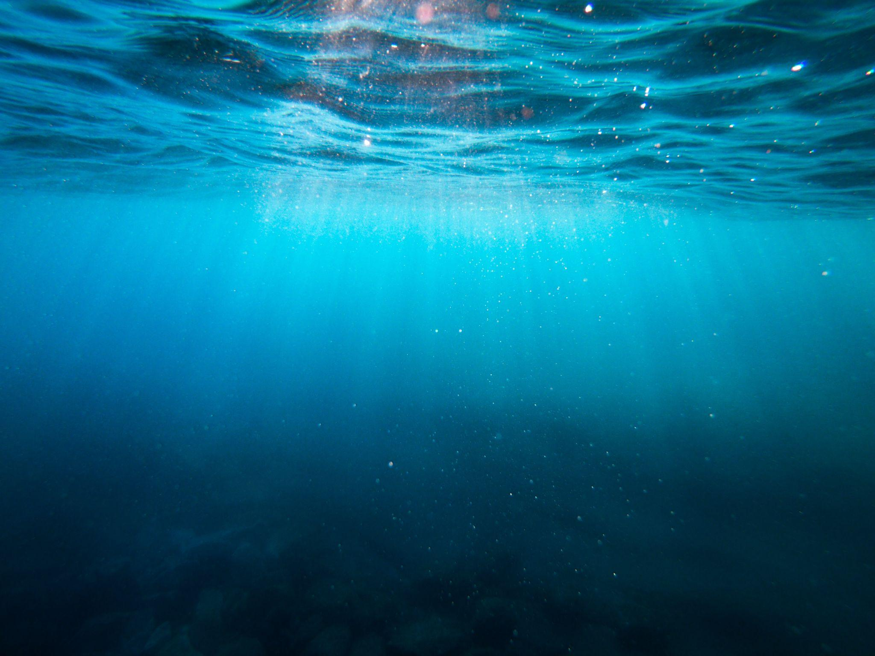



Slide 2
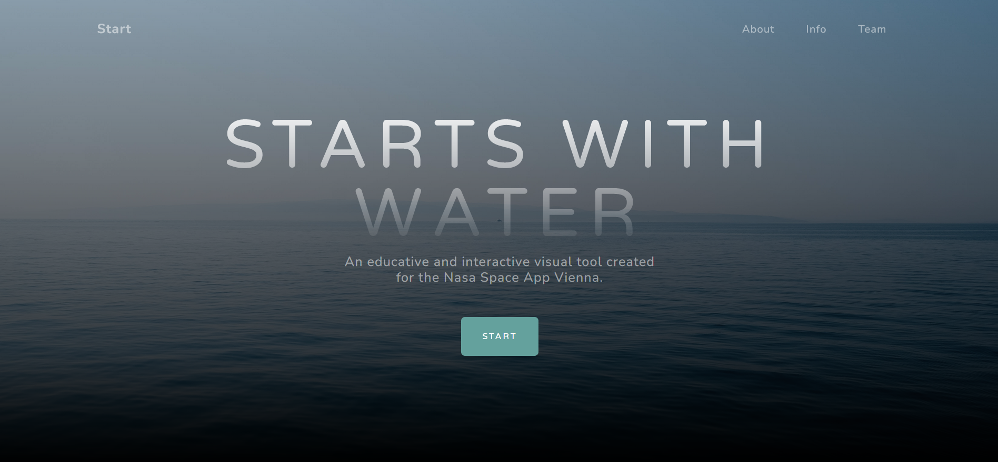

Slide 3
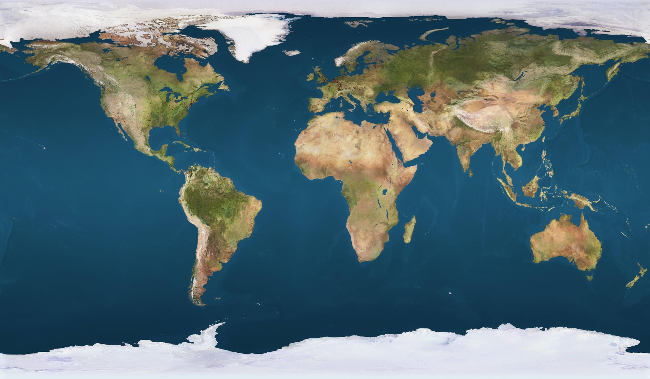




2023
27 years left

Slide 4
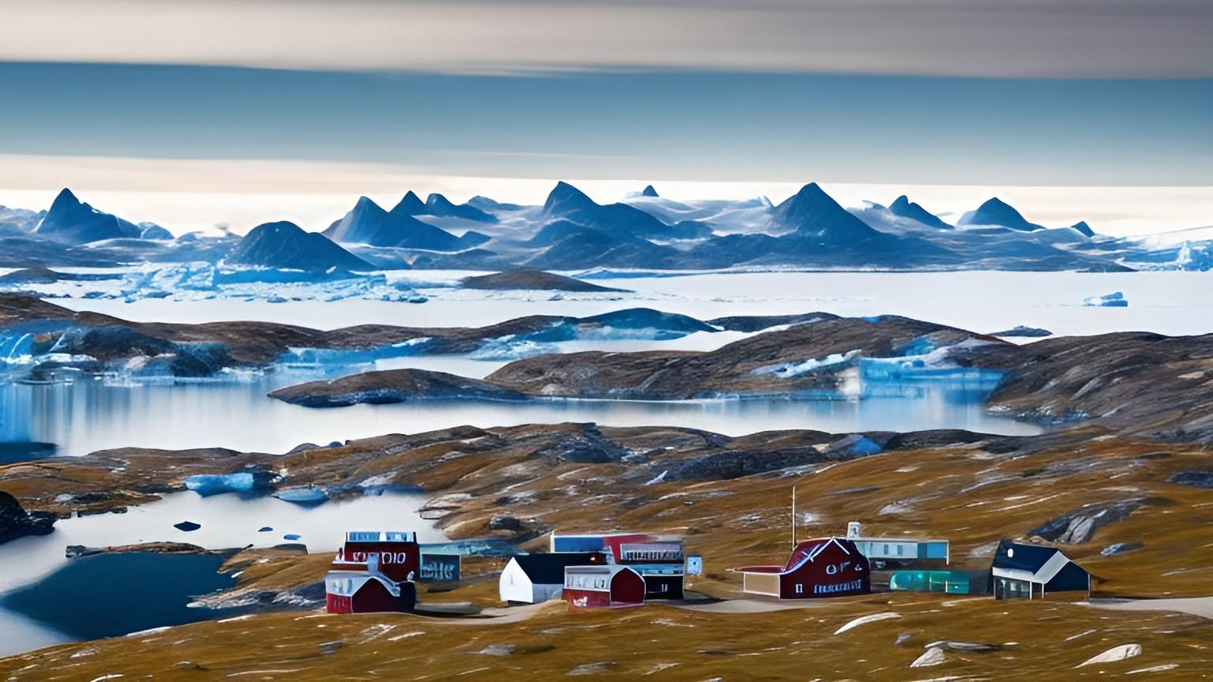
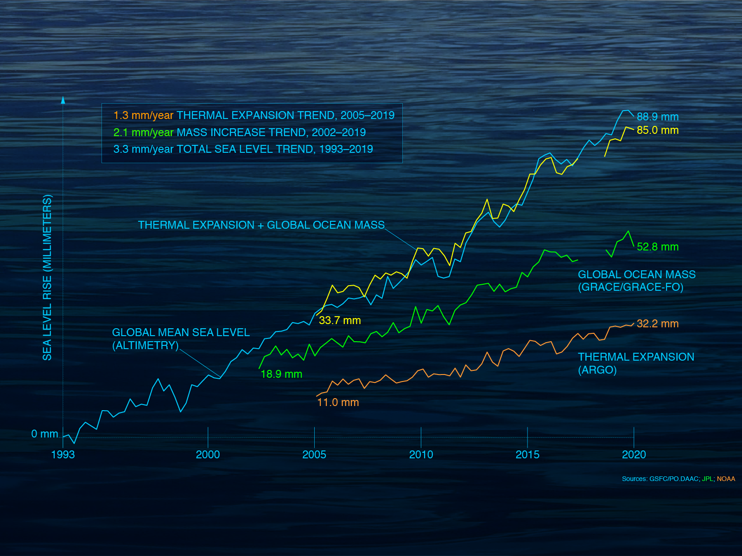
Greenland
GREENLAND
Location: Greenland is a country of the American continent.
Issue: Greenland is almost completely covered in ice. The country's inhabitants live on the coast (which is ice-free and full of fjords). The Greenland ice sheet is melting due to global warming. The island accumulates 10% of the planet's freshwater and, if it were to melt entirely, it could raise sea levels by almost 10 meters.

Slide 5
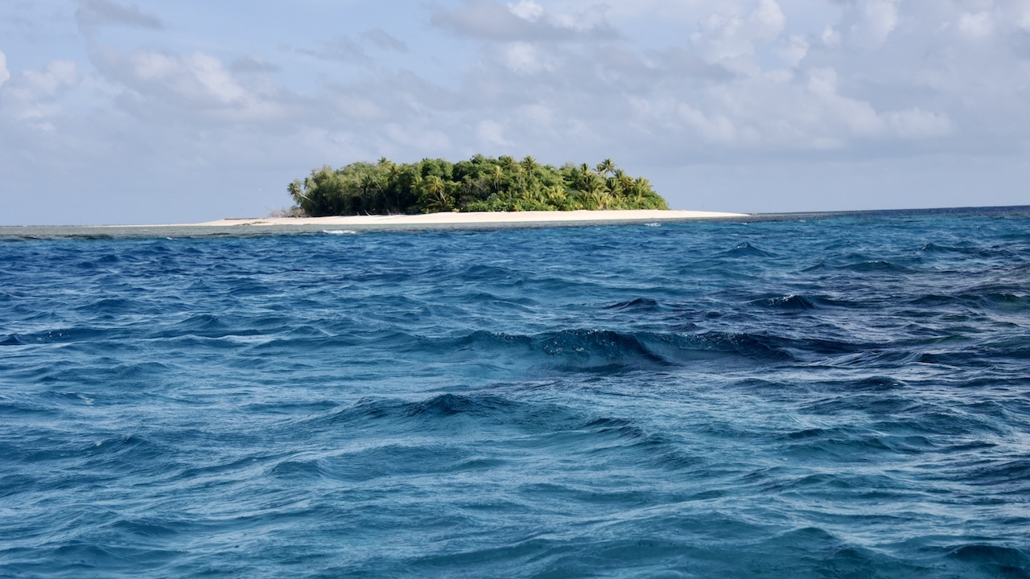
Tuvalu´s Sea Level Threat
Scoreboard
Lucy
Sophia
Marnie
John
…
11. Rosie (You)
Why is Tuvalu so endangered by rising sea levels?
higher tides
tsunamis
most of the land is very low
lack of fresh water
Notes:
Quiz

Slide 6
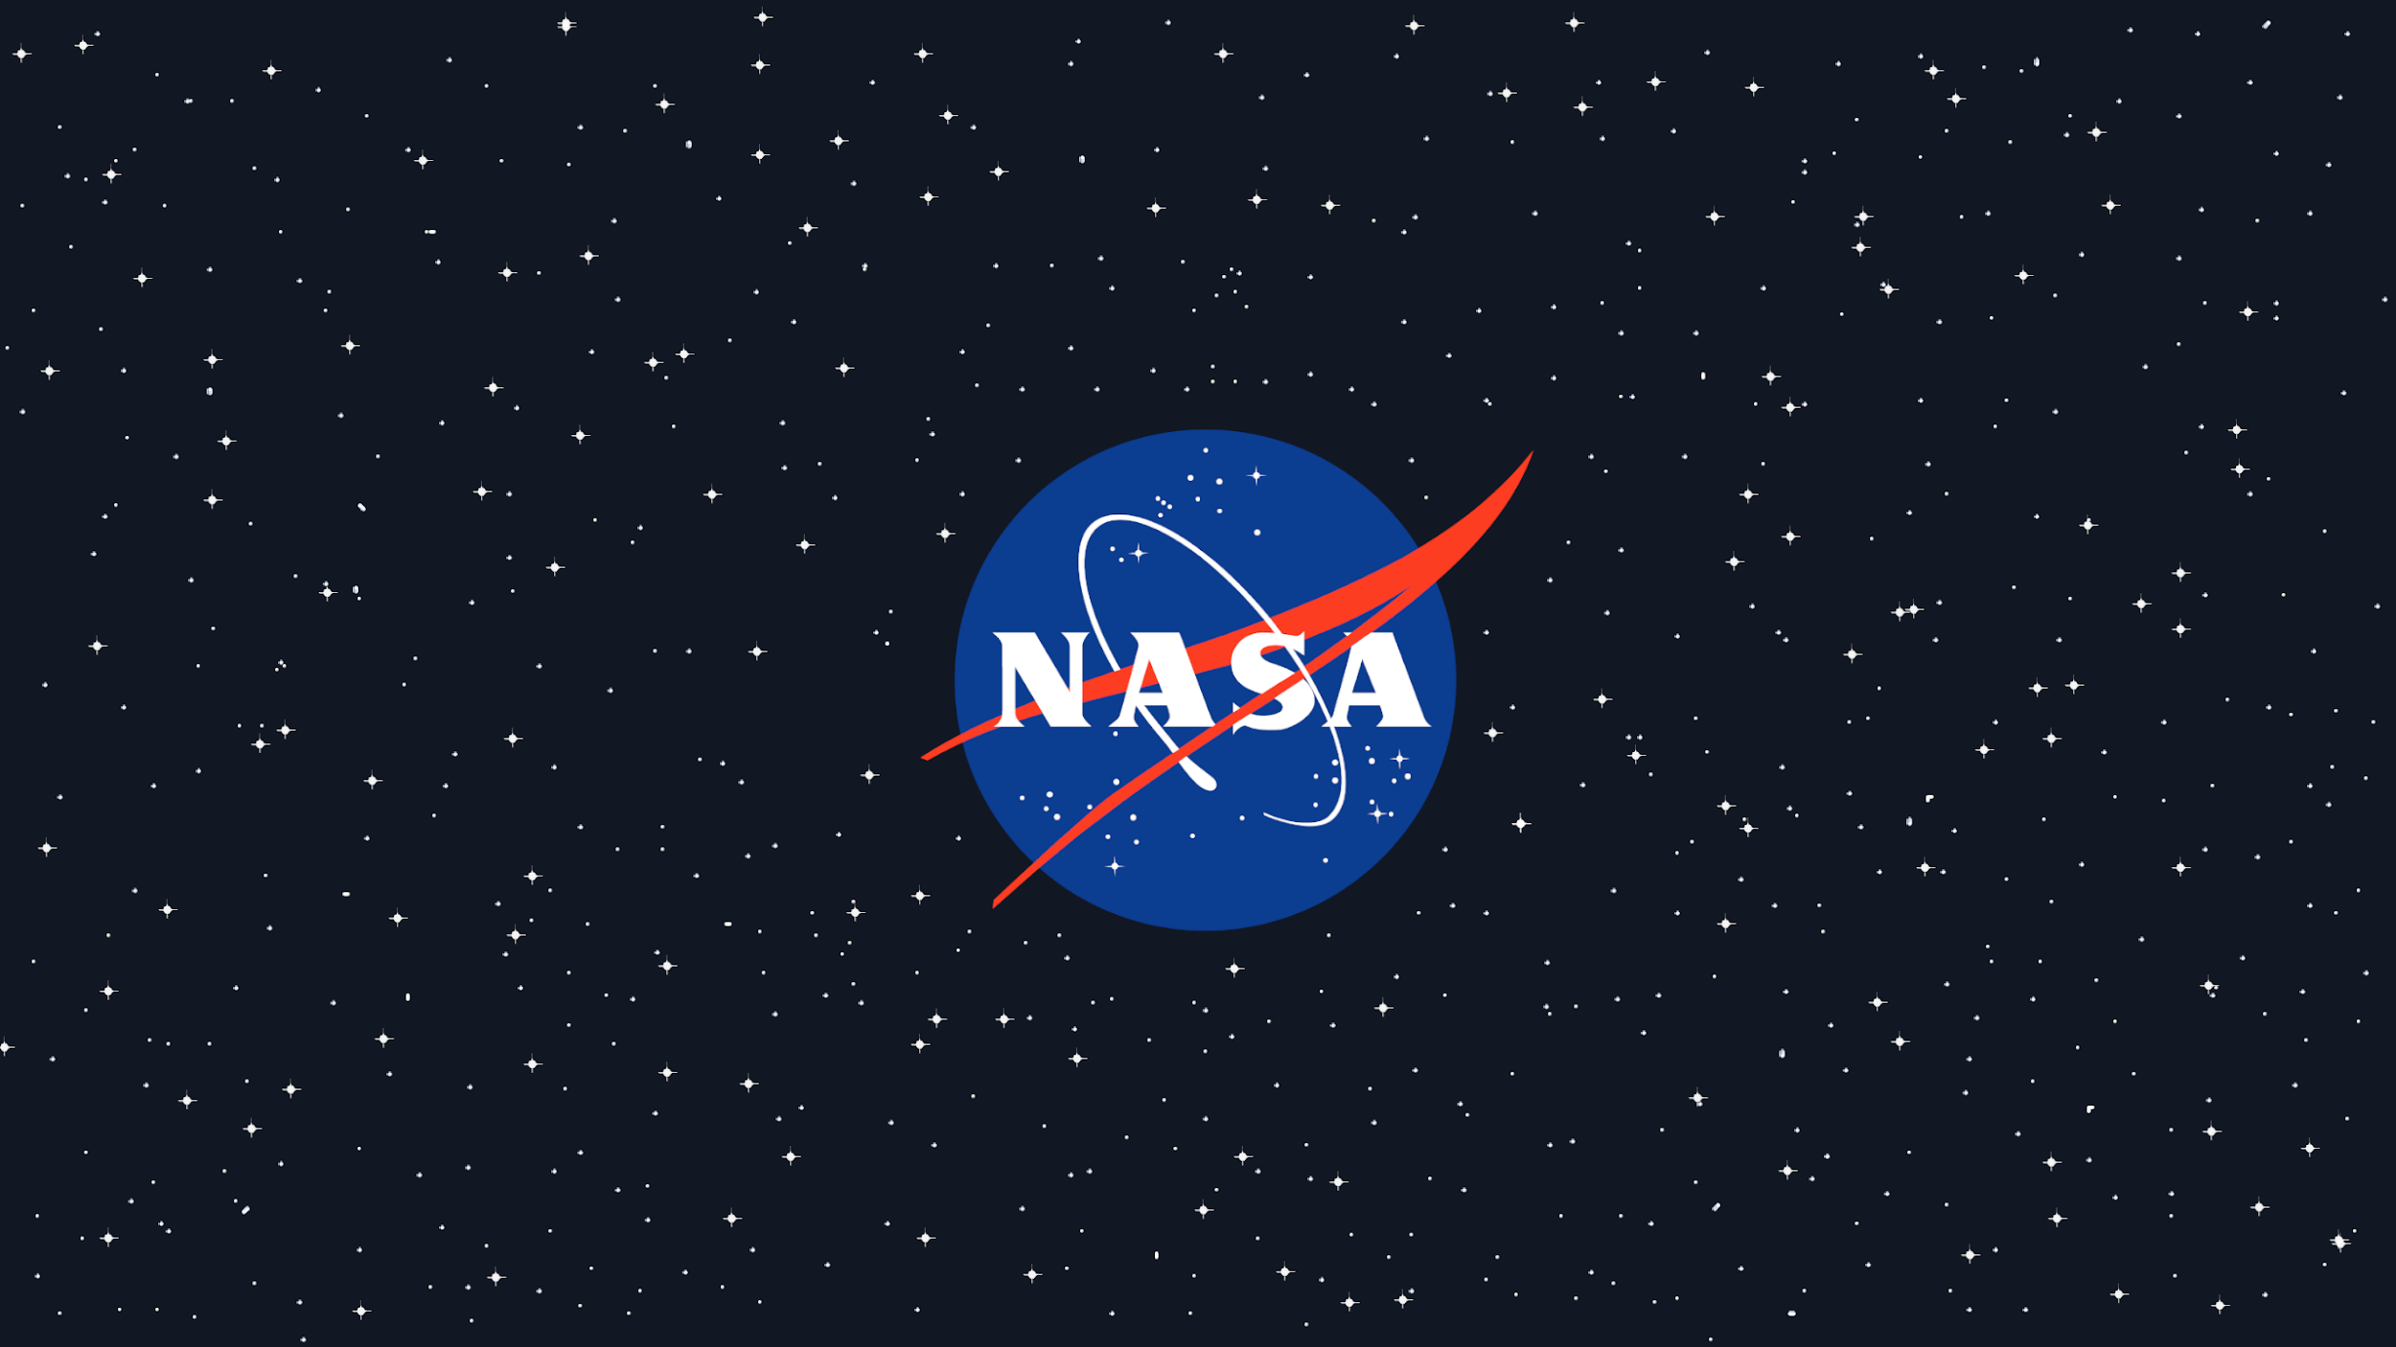
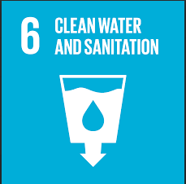
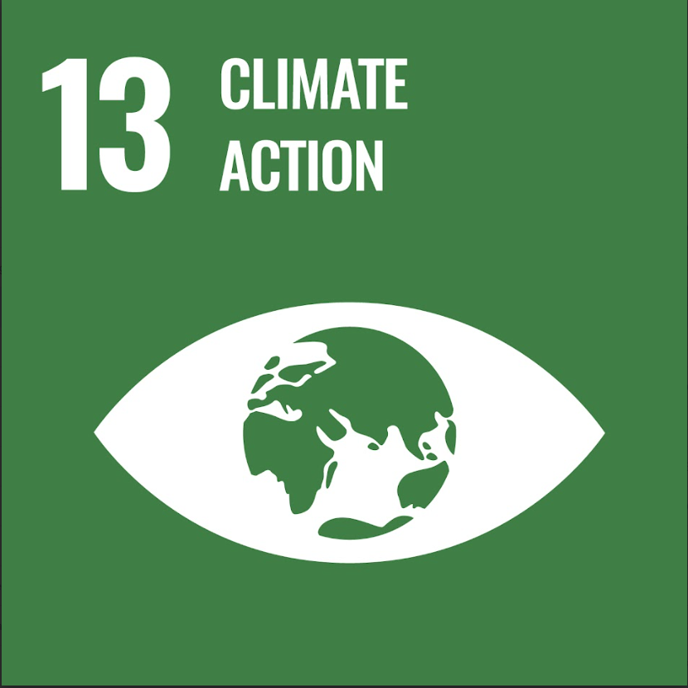
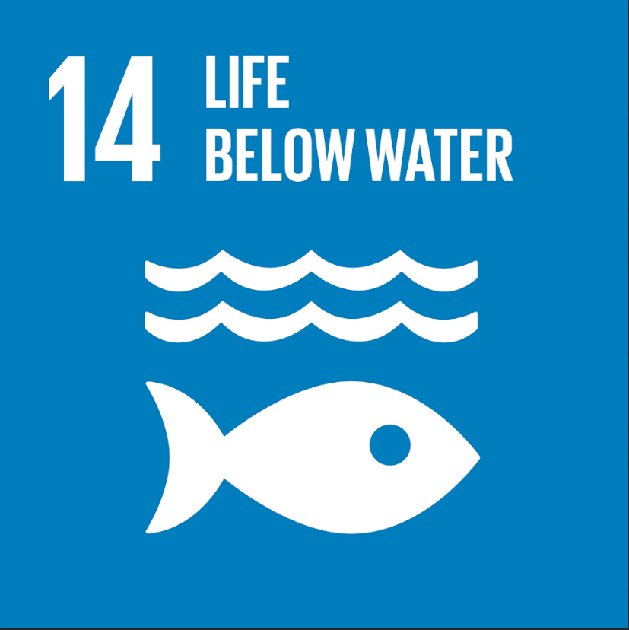

How NASA is trying to help
🡨
UN-Agenda Goals
NASA SWOT mission
NASA SMAP mission
NASA GPM mission
NASA GRACE mission
NASA GRACE-FO mission
NASA Migration-Trends

Slide 7
